Slide 1
Determining the Effectiveness of Computer-Based National Exams

Slide 2
Importance
Education is one of factor that affects economic growth of a country.
Indonesia is a developing country, analysis in their factors are important.
National Exams is a way of measuring the Education level of a country.
Since 2015, National Exams in Indonesia are computer-based.
Creating an effective way to measure education level, could help country to distribute its budget on education efficiently.

Slide 3
Data Source & Cleaning
Indonesia’ GRP per capita per province which is scraped from Wikipedia (https://en.wikipedia.org/wiki/List_of_Indonesian_provinces_by_GRP_per_capita).
  Drop all columns except province and Nominal GRP per capita in USD
Indonesia’s National exam average per provinces, which are scraped from the official websites by the Ministry of Education and Culture of Indonesia (https://puspendik.kemdikbud.go.id/hasil-un/).
  Drop columns for number of participants; Catholic and Protestant Test Score
Drop North Kalimantan Row
Change all unknown values to its mean of the province’s total average score

Slide 4
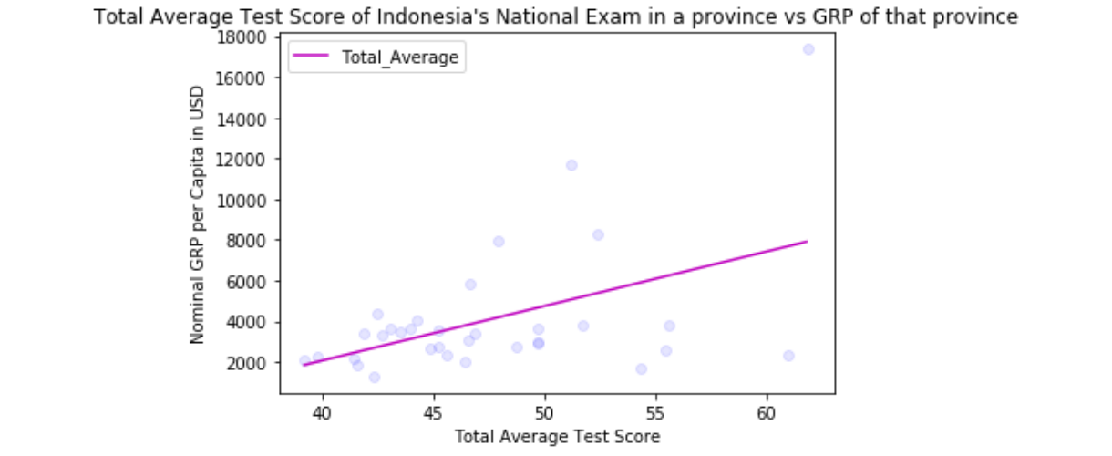
Total Average Test Score vs Nominal GRP per Capita
Coefficient = 267.7571107

Slide 5
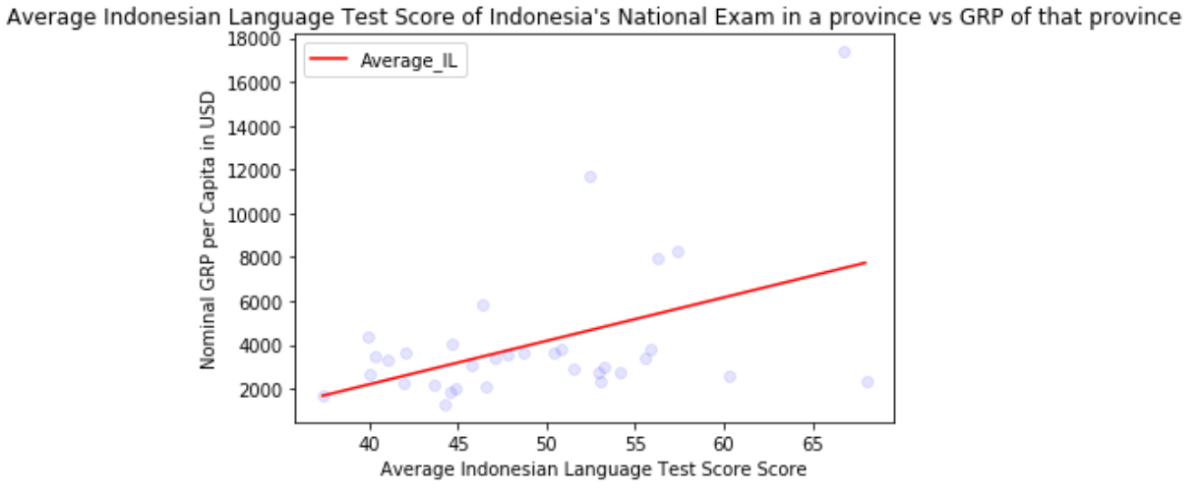
Average Indonesian Language Test Score vs Nominal GRP per Capita
Coefficient = 198.09922167

Slide 6
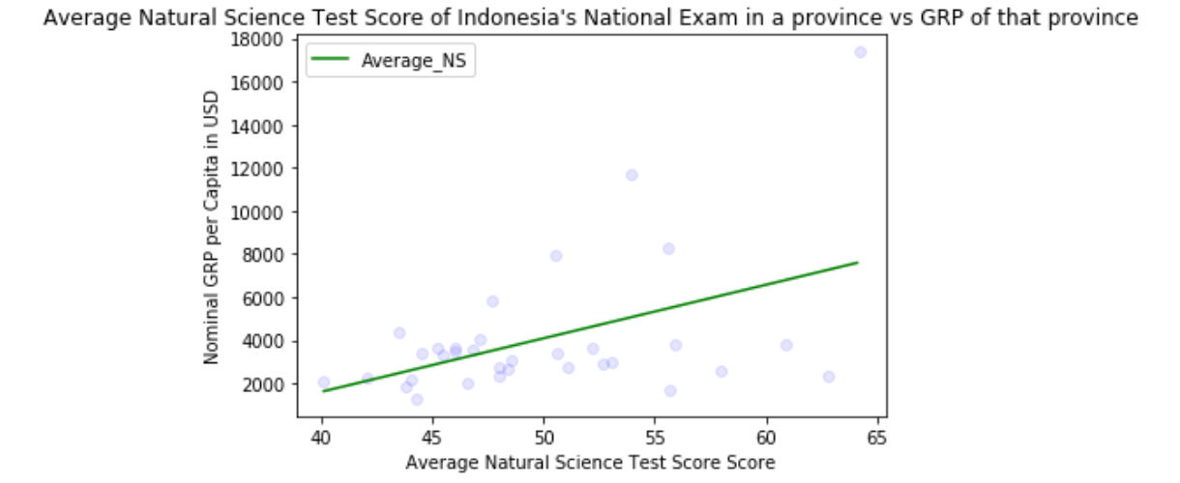
Average Natural Science Test Score vs Nominal GRP per Capita
Coefficient = 248.05090117

Slide 7
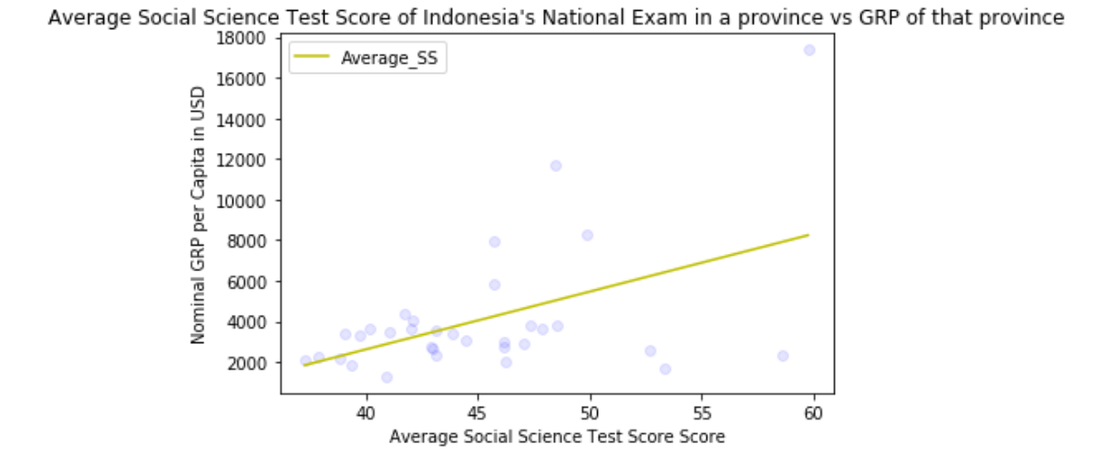
Average Social Science Test Score vs Nominal GRP per Capita
Coefficient = 284.12356779

Slide 8
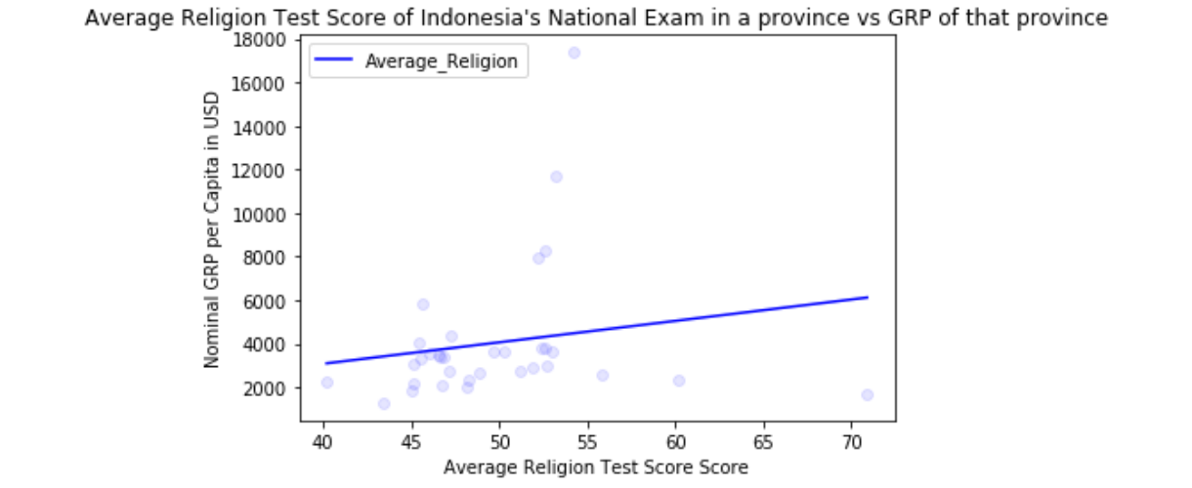
Average Religion Test Score vs Nominal GRP per Capita
Coefficient = 98.25103321

Slide 9
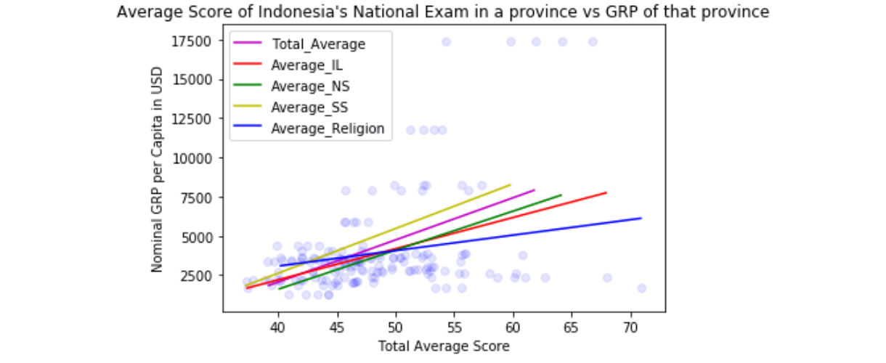
Analysis
As the result suggest, every test scores have a positive correlation with the GRP
This suggests that the computer based national exams could be one of indicator for Indonesia’ GRP per capita
Therefore the Computer Based National Exams are effective enough

Slide 10
CONCLUSION
COMPUTER-BASED NATIONAL EXAMS ARE EFFECTIVE AND IS A GREAT INDICATOR FOR GRP PER CAPITA INCREASE

Slide 11
Future Recommendations
Use more data in the future (not only 2017 as this study have done)
Using clustering to provide which regions are in need of more education services attention from government

